Slide 1

SALES DATA ANALYSIS -REPORT
BLOSSOM ACADEMY – MID COURSE PROJECT

Slide 2

INTRODUCTION
01
DATA ANALYST
ANDREWS

Slide 3
OBJECTIVES
The main objective behind this analysis, is to extensively analyze the dataset from the marketing team of the Company, and then come up with ways the company can maximize Sales in order to make the company a profitable one.

Slide 4
PROBLEM STATEMENT
A multinational retail company decides to embark on a campaign called 'Operation Increase Sales and Profit' (OISP) which focuses on increasing the sales of the company and maximizing profit.
Before the management team of the company can take any actionable decision with regards to the campaign,they want to draw the necessary insight from their 'sitting data'.

Slide 5
TASKS
Analyze the given data and advise management on what to do to increase sales and profit as intended in the campaign.
Kindly outlay your analytical steps inline with CRISP-DM(Cross Industry Standard Process for Data Mining)steps, asking the necessary questions and providing answers based on the data.
Management expects statistical summaries of the key variables considering the aim of the campaign, visualizations and a report on your findings and your advice.

Slide 6
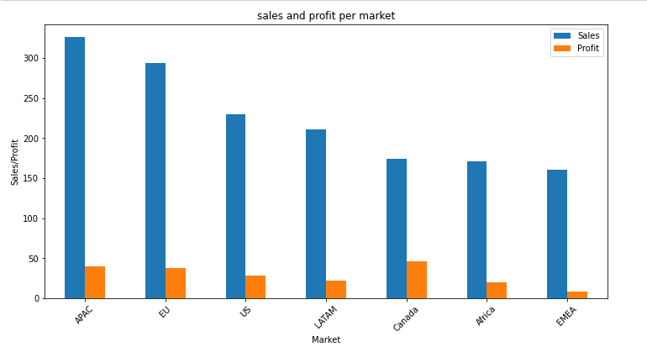
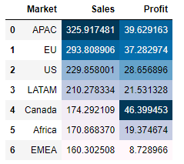
Various markets with their corresponding Sales and Profit
From the graph, we can Identify the various markets the company works with, and that shows that per sales, the APAC market took the lead, but with profits, the CANADIAN market did well.

Slide 7
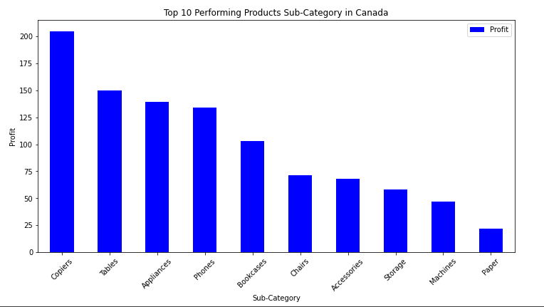
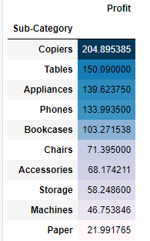
Analyzing Canadian Market
Per analysis in the Canadian market, these are the top 10 product sub-categories in the market that are yielding more profits. Hence it’s prudent that the company invests more on the Canadian market and specifically, these product sub-categories.

Slide 8
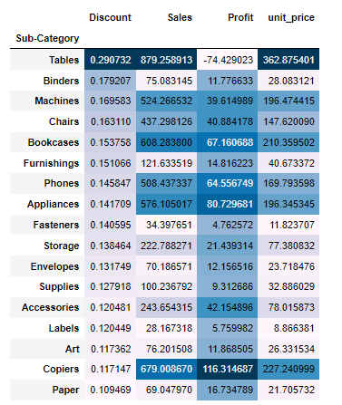
Highest Discounted Product Sub-Categories and it’s effect on Sales and Profits.
From the analysis made, we can deduce that, Customers are moved by the discount rate of a particular product, as it is seen with Tables, as a sub_category. But that does not yield profit, so, I will recommend that the company focuses on giving more discount to Copiers sub_category.

Slide 9
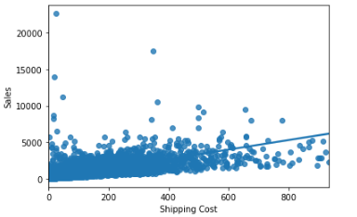
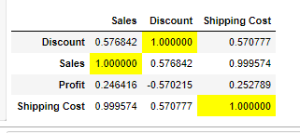
Correlation between Shipping Cost and Sales
From the chart, we can see a great magnitude towards the shipping Cost, with which a linear line can even be drawn. This shows that the Shipping cost, has an Influence on the Sales.

Slide 10
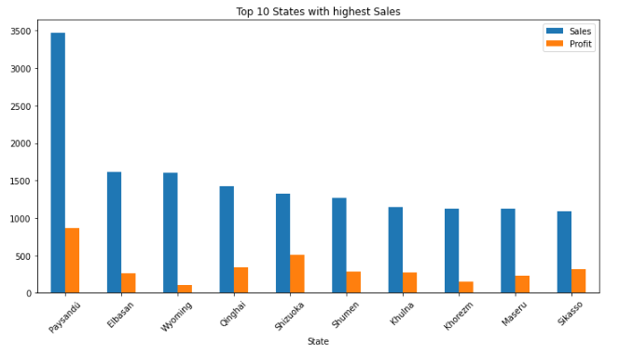
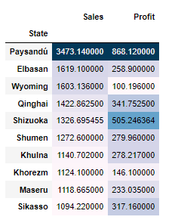
The General Sales Performance of the various States – (10)
The graph above highlights on the states with the highest Sales. Generally, hence that can also Influence the directors on where to focus on, as States are concerned.

Slide 11
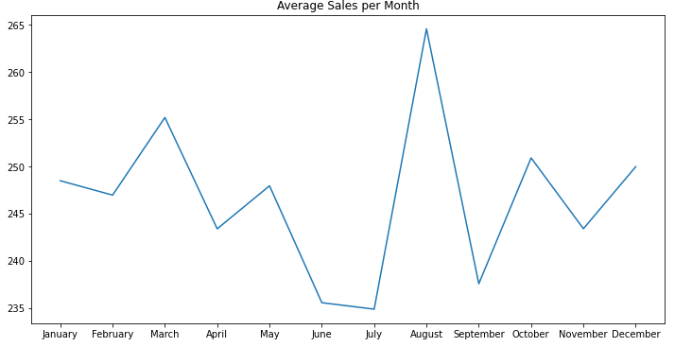
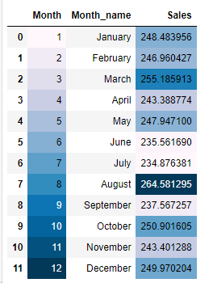
Trend of Sales over the year

Slide 12
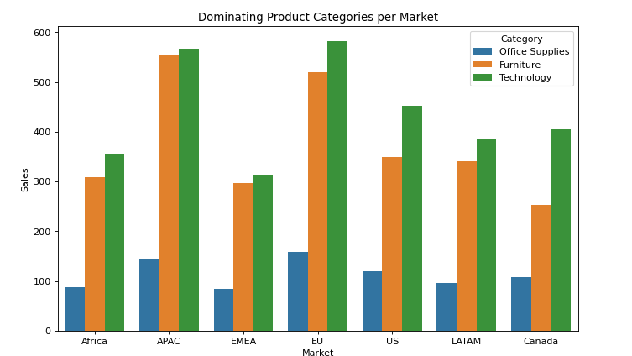
Dominating Product Categories per Market

Slide 13
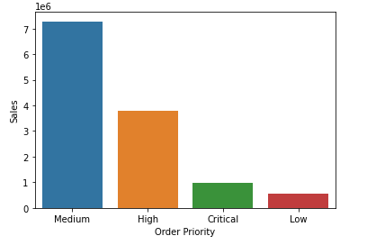
Order Priorities with highest Sales

Slide 14
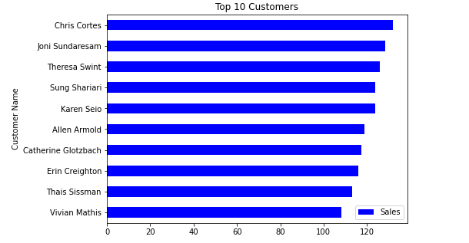
Top 10 Customers

Slide 15
CONCLUSION
The main basics of my Analysis made on the Marketing data were focused on 4 main Factors;
Various Markets and their corresponding Sales.
Analysis on Canadian Market.
Discounted products and their effect on sales.
Correlation between Shipping cost and sales.
Per the Analysis made, I noticed that, Sales in the APAC market are very high as compared to the other markets, but the Canadian market’s sales yielded more profit even with less sales made, hence the main focus with respect to the market for the company should be the Canadian Market. An Increase in the sales of the Canadian Market will yield lots of profit for the company.
I personally also realized that, the Tables Sub-Category is highly discounted, but not really yielding profit, meaning the company must review the discount on that, but increase the discount rate for Copiers Sub-Category, because even though the discount is low, it’s still attracting much profit than the others.
This amongst others stated above, if carefully considered, can help boost the Sales and Profits of the Company.

Slide 16
THANK YOU

